Slide 1
Mathematics
Common Core State Standards
Thursday, August 16th, 2012

Slide 2
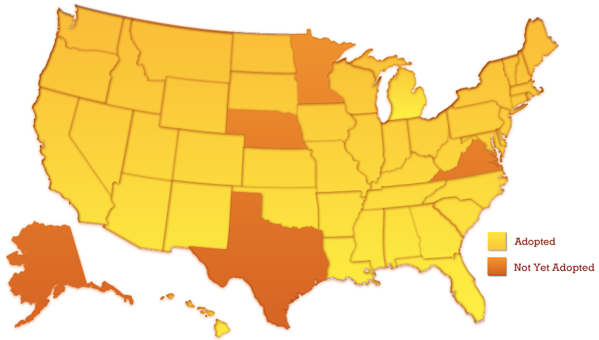
States Adopting the Common Core State Standards
*Minnesota adopted the CCSS in ELA/literacy only
Notes:
TALKING POINTS:
45 States and the District of Columbia have adopted the Common Core State Standards
Most states are committed to implementing the standards by the 2014-2015 school year

Slide 3
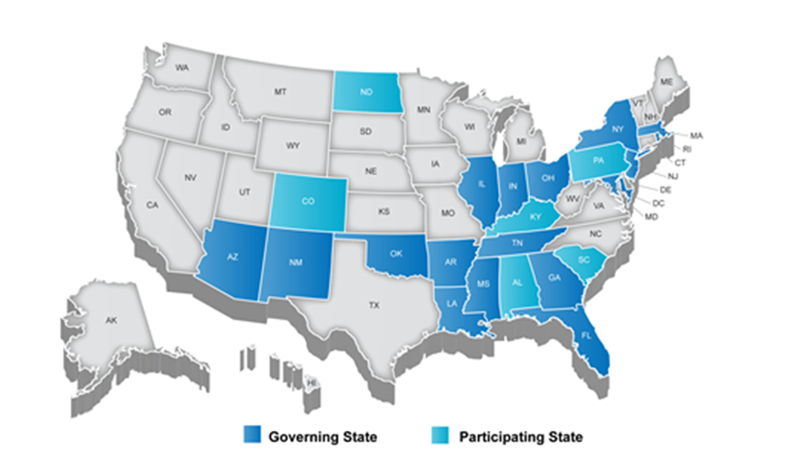
Partnership for Assessment of Readiness for College and Careers (PARCC)
Notes:
TALKING POINTS
PARCC is an alliance of 25 states, educating nearly 25 million students, that are working together to develop a common set of K-12 assessments in English and math anchored in what it takes to be ready for college and careers. PARCC is led by 16 governing board states (and D.C.) represented in Dark Blue.
CLICK: The chair of the governing board is Mitchell Chester, Education Commissioner of Massachusetts, and the state of Florida is serving as its fiscal agent.
CLICK: Achieve is the project manager for PARCC, essentially serving as the staff for the consortium and coordinating the work. Collectively the PARCC states educate nearly 25 million students.
Governing States will pilot and field test the assessment system components over the next three years and administer the new assessment system during the 2014-15 school year. Governing States will use the results from the PARCC assessments in their state accountability systems
The chief state school officers of the Governing States serve on the PARCC Governing Board and make decisions on behalf of the Partnership on major policies and operational procedures
Participating States (light blue) provide staff to serve on PARCC’s design committees, working groups, and other task forces established by the Governing Board to conduct the work necessary to design and develop PARCC’s proposed assessment system. By 2014–15, any state that remains in PARCC must commit to statewide implementation and administration of the Partnership’s assessment system Any PARCC Participating State prepared to make the commitments and take on the responsibilities of a Governing State can become one
NOTES
Governing Board: Comprised of K-12 chiefs from Governing Board States
Technical Advisory Committee: Comprised of state/national assessment experts
Leadership Team: Comprised of delegates of K-12 chiefs from Governing Board States (e.g., Assoc. Supt for Curriculum, Assessment and/or Instruction)
ACCR: Comprised of national and state postsecondary leaders
Operational Working Groups: Comprised of national, state, and local experts and leaders in their specific areas of expertise

Slide 4
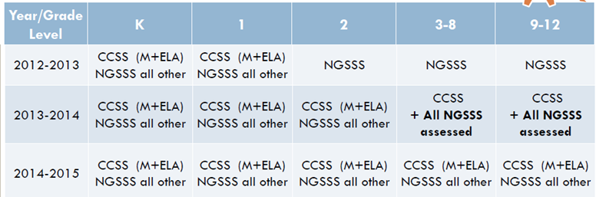
What Standards Should I be Teaching?
Florida’s Next Generation (NGSSS)
Common Core Sunshine State Standards (CCSS)
Notes:
Teresa Sweet
Full implementation of CCSS beginning with Kindergarten in 2011-12
It is essential that complex, rich, informational text become an integral part of instruction for reading and writing beginning with Kindergarten; informational text should include topics related to History, Social Studies, Science, and Technical Subjects at every grade level.
2013-14 will be our year of transition for grades 3 through 12. Instruction should be blended (a combination of the CCSS and NGSSS) as appropriate to ensure there are no gaps in presentation of the content. The Department will provide guidance related to blended instruction for each grade and content area.

Slide 5
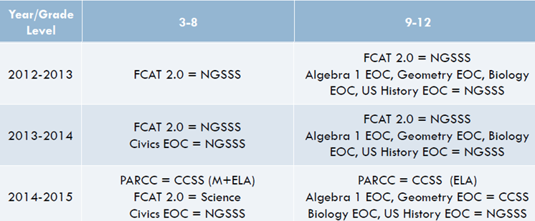
What Will Be Tested on Statewide Assessments?
Notes:
Teresa Sweet
Full implementation of CCSS beginning with Kindergarten in 2011-12
It is essential that complex, rich, informational text become an integral part of instruction for reading and writing beginning with Kindergarten; informational text should include topics related to History, Social Studies, Science, and Technical Subjects at every grade level.
2013-14 will be our year of transition for grades 3 through 12. Instruction should be blended (a combination of the CCSS and NGSSS) as appropriate to ensure there are no gaps in presentation of the content. The Department will provide guidance related to blended instruction for each grade and content area.

Slide 6
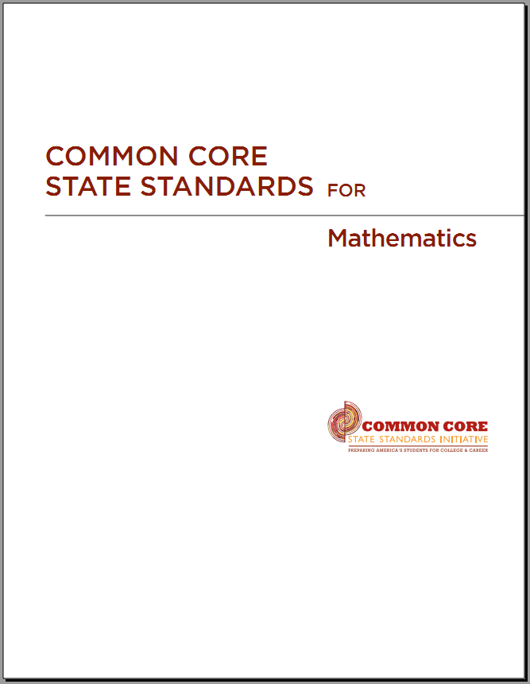
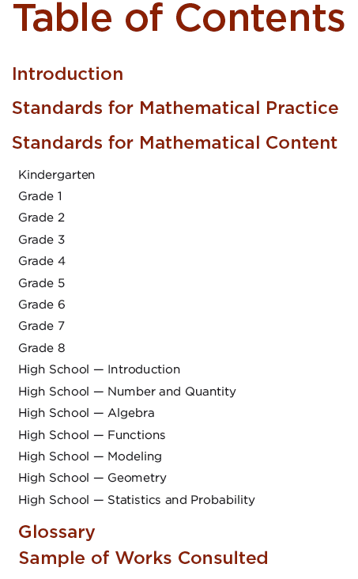
Notes:
www.corestandards.org
Standards
Content

Slide 7
CCSS Design and Organization
Domains are larger groups that progress across grades
Clusters are groups of related standards
Content standards define what students should understand and be able to do

Slide 8
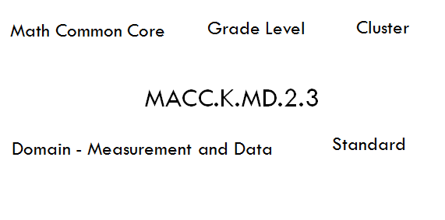
Florida’s Design and Organization

Slide 9
The Six Shifts in Mathematics
Shift One: Focus
Shift Two: Coherence
Shift Three: Deep Understanding
Shift Four: Fluency
Shift Five: Application
Shift Six: Intensity

Slide 10
Focusing attention within Number and Operations
Similar to Florida’s NGSSS
 | Operations and Algebraic Thinking |  |  |  |  |  |  | Expressions and Equations |  |  |  | Algebra
 |  |  |  |  |  |  | → |  |  |  | →
 | Number and Operations—Base Ten |  |  |  |  |  | → | The Number System
 |  |  |  |  |  |  |  |  |  |  | →
 |  |  |  | Number and Operations—Fractions |  |  | →
 | K | 1 | 2 | 3 | 4 | 5 |  | 6 | 7 | 8 |  | High School

Slide 11
Mathematical Practices
Make sense of problems and persevere in solving them.
Reason abstractly and quantitatively.
Construct viable arguments and critique the reasoning of others.
Model with mathematics.
Use appropriate tools strategically.
Attend to precision.
Look for and make use of structure.
Look for and express regularity in repeated reasoning.
Notes:
Here are the 8 mathematical practices that extend throughout the Common Core State Standards.
“The Standards for Mathematical Practice describe varieties of expertise that mathematics educators at all levels should seek to develop in their students”
(CCSS, 2010, p. 6).

Slide 12
Classroom Tips for Success
Students should be using counters or connecting cubes
Students should be using ten frames
There should be a math specific word wall or word wall with math words on it
Teachers should be encouraging students to justify their answers

Slide 13

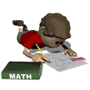
Math Block
The Nonnegotiables
Warm-up
Calendar Math
Rocket Math
Whole group instruction
Math Workshop
Wrap-up
Notes:
Warm-up (Review)
Calendar Math – with support teachers
Rocket math is for automaticity of math facts (simply for practice, not a graded assessment)

Slide 14
Components of GO Math
Teacher manual
Objectives
Essential questions
Video clips and Technology Links
Differentiated Instruction Activities for Math Lab
Grab N Go Math Centers Kit
Think Central

Slide 15
1st Ten Days of Math
Allows you time to set-up procedures and protocols for math lab
Introduces key concepts/vocabulary
BOY Assessment
Reviewing Data on August 29th!

